Slide 1


Chapter 6
Deadlock

Slide 2
Deadlock
Concepts: system deadlock: no further progress
four necessary & sufficient conditions
Models: deadlock - no eligible actions
Practice: blocked threads
Aim: deadlock avoidance - to design systems where deadlock cannot occur.

Slide 3
Deadlock: four necessary and sufficient conditions
Serially reusable resources:
the processes involved share resources which they use under mutual exclusion.
Incremental acquisition:
processes hold on to resources already allocated to them while waiting to acquire additional resources.
No pre-emption:
once acquired by a process, resources cannot be pre-empted (forcibly withdrawn) but are only released voluntarily.
Wait-for cycle:
a circular chain (or cycle) of processes exists such that each process holds a resource which its successor in the cycle is waiting to acquire.

Slide 4
Wait-for cycle
Has A awaits B
A
Has E awaits A
E
B
Has B awaits C
D
C
Has C awaits D
Has D awaits E

Slide 5
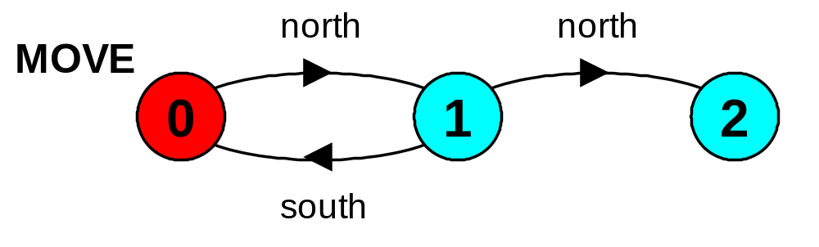
6.1 Deadlock analysis - primitive processes
deadlocked state is one with no outgoing transitions
in FSP: STOP process
MOVE = (north->(south->MOVE|north->STOP)).
animation to produce a trace.
analysis using LTSA:
(shortest trace to STOP)
    Trace to DEADLOCK:
    north
    north

Slide 6
deadlock analysis - parallel composition
in systems, deadlock may arise from the parallel composition of interacting processes.
RESOURCE = (get->put->RESOURCE).
P = (printer.get->scanner.get
->copy
->printer.put->scanner.put
->P).
Q = (scanner.get->printer.get
->copy
->scanner.put->printer.put
->Q).
||SYS = (p:P||q:Q
||{p,q}::printer:RESOURCE
||{p,q}::scanner:RESOURCE
).
SYS
p:P
printer:
printer
RESOURCE
scanner
get
put
q:Q
scanner:
printer
RESOURCE
scanner
get
put
Deadlock Trace?
Avoidance?

Slide 7
deadlock analysis - avoidance
acquire resources in the same order?
Timeout:
P = (printer.get-> GETSCANNER),
GETSCANNER = (scanner.get->copy->printer.put
->scanner.put->P
|timeout -> printer.put->P
).
Q = (scanner.get-> GETPRINTER),
GETPRINTER = (printer.get->copy->printer.put
->scanner.put->Q
|timeout -> scanner.put->Q
).
Deadlock? Progress?

Slide 8
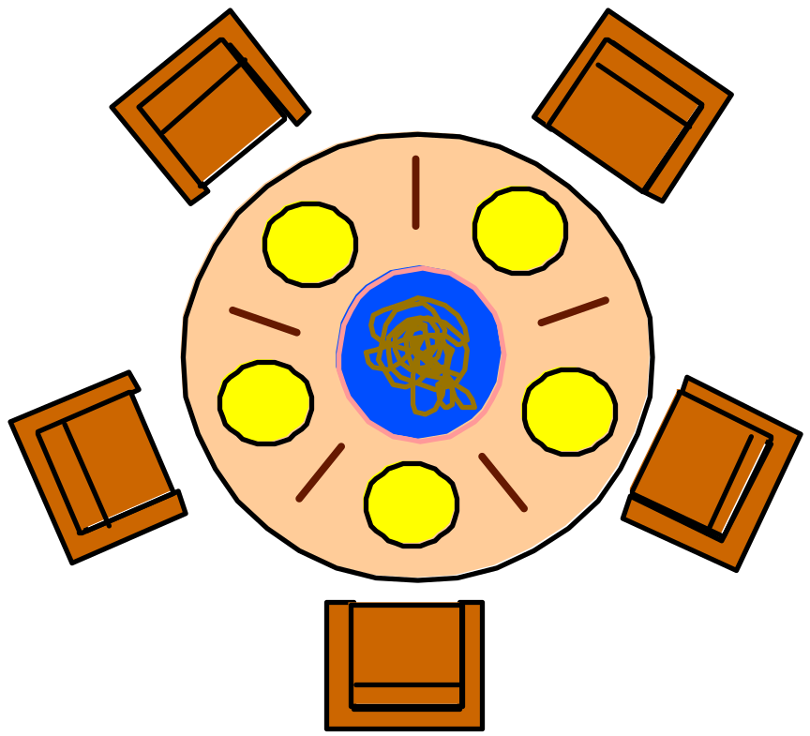
6.2 Dining Philosophers
Five philosophers sit around a circular table. Each philosopher spends his life alternately thinking and eating. In the centre of the table is a large bowl of spaghetti. A philosopher needs two forks to eat a helping of spaghetti.
3
2
2
3
1
4
1
4
0
One fork is placed between each
pair of philosophers and they agree that each will only use the fork to his immediate right and left.
0

Slide 9
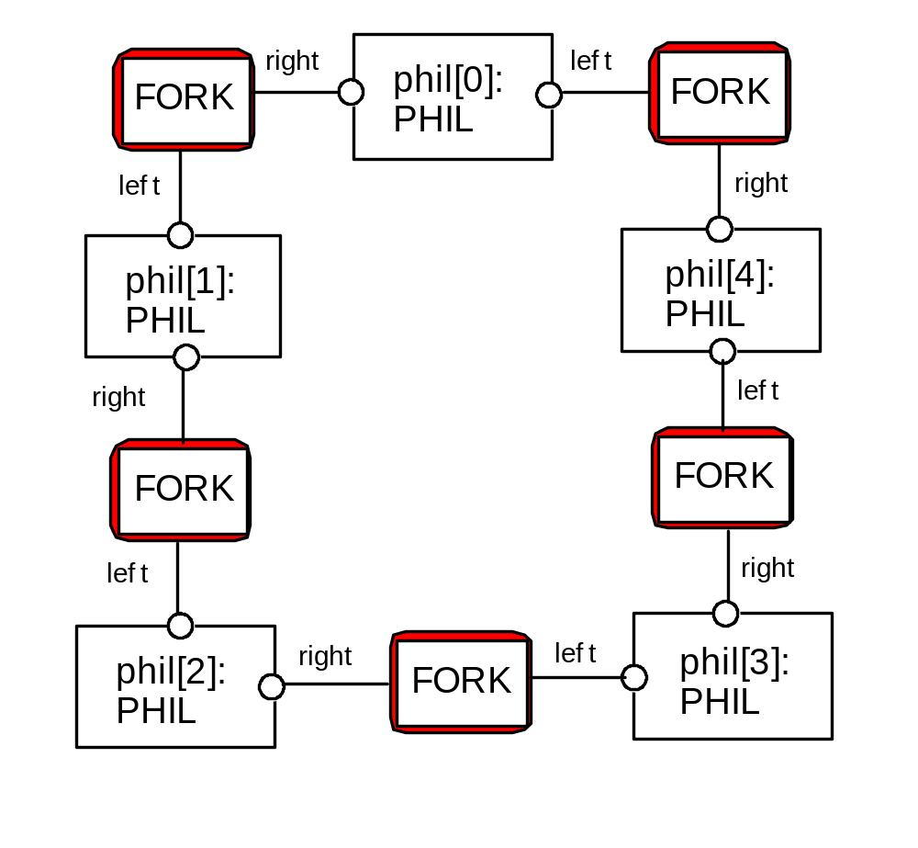
Dining Philosophers - model structure diagram
Each FORK is a shared resource with actions get and put.
When hungry, each PHIL must first get his right and left forks before he can start eating.

Slide 10
Dining Philosophers - model
FORK = (get -> put -> FORK).
PHIL = (sitdown ->right.get->left.get
->eat ->right.put->left.put
->arise->PHIL).
Table of philosophers:
||DINERS(N=5)= forall [i:0..N-1]
(phil[i]:PHIL ||
{phil[i].left,phil[((i-1)+N)%N].right}::FORK
).
Can this system deadlock?

Slide 11
Dining Philosophers - model analysis
    Trace to DEADLOCK:
    phil.0.sitdown
    phil.0.right.get
    phil.1.sitdown
    phil.1.right.get
    phil.2.sitdown
    phil.2.right.get
    phil.3.sitdown
    phil.3.right.get
    phil.4.sitdown
    phil.4.right.get
This is the situation where all the philosophers become hungry at the same time, sit down at the table and each philosopher picks up the fork to his right.
The system can make no further progress since each philosopher is waiting for a fork held by his neighbor i.e. a wait-for cycle exists!

Slide 12
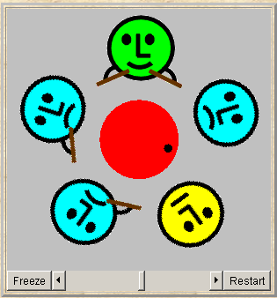
Dining Philosophers
Deadlock is easily detected in our model.
How easy is it to detect a potential deadlock in an implementation?

Slide 13
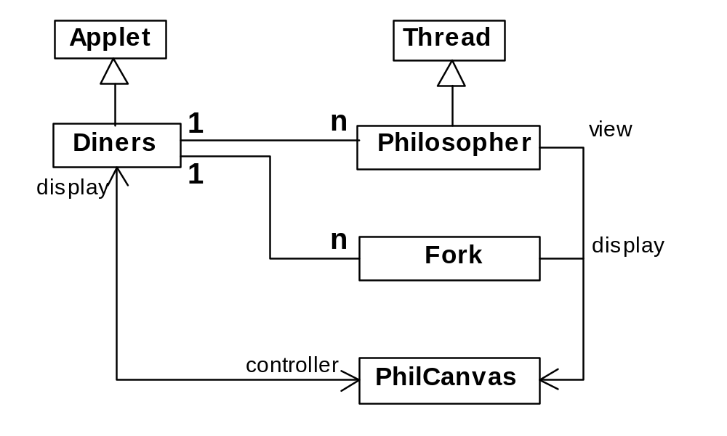
Dining Philosophers - implementation in Java
philosophers: active entities - implement as threads
forks: shared passive entities - implement as monitors
display

Slide 14
Dining Philosophers - Fork monitor
class Fork {
private boolean taken=false;
private PhilCanvas display;
private int identity;
Fork(PhilCanvas disp, int id)
{ display = disp; identity = id;}
synchronized void put() {
taken=false;
display.setFork(identity,taken);
notify();
}
synchronized void get()
throws java.lang.InterruptedException {
while (taken) wait();
taken=true;
display.setFork(identity,taken);
}
}
taken encodes the state of the fork

Slide 15
Dining Philosophers - Philosopher implementation
class Philosopher extends Thread {
...
public void run() {
try {
while (true) { // thinking
view.setPhil(identity,view.THINKING);
sleep(controller.sleepTime()); // hungry
view.setPhil(identity,view.HUNGRY);
right.get(); // gotright chopstick
view.setPhil(identity,view.GOTRIGHT);
sleep(500);
left.get(); // eating
view.setPhil(identity,view.EATING);
sleep(controller.eatTime());
right.put();
left.put();
}
} catch (java.lang.InterruptedException e){}
}
}
Follows from the model (sitting down and leaving the table have been omitted).

Slide 16
Dining Philosophers - implementation in Java
Code to create the philosopher threads and fork monitors:
for (int i =0; i<N; ++i)
fork[i] = new Fork(display,i);
for (int i =0; i<N; ++i){
phil[i] =
new Philosopher
(this,i,fork[(i-1+N)%N],fork[i]);
phil[i].start();
}

Slide 17
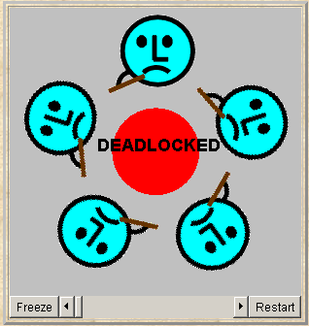
Dining Philosophers
To ensure deadlock occurs eventually, the slider control may be moved to the left. This reduces the time each philosopher spends thinking and eating.
This "speedup" increases the probability of deadlock occurring.

Slide 18
Deadlock-free Philosophers
Deadlock can be avoided by ensuring that a wait-for cycle cannot exist. How?
PHIL(I=0)
= (when (I%2==0) sitdown
->left.get->right.get
->eat
->left.put->right.put
->arise->PHIL
|when (I%2==1) sitdown
->right.get->left.get
->eat
->left.put->right.put
->arise->PHIL
).
Introduce an asymmetry into our definition of philosophers.
Use the identity I of a philosopher to make even numbered philosophers get their left forks first, odd their right first.
Other strategies?

Slide 19
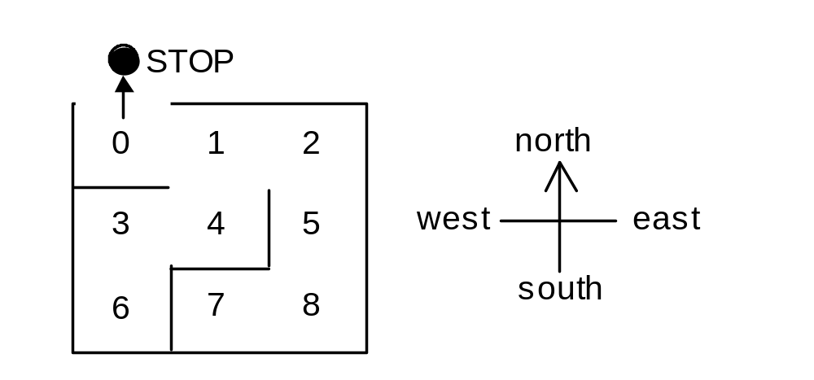
Maze example - shortest path to “deadlock”
We can exploit the shortest path trace produced by the deadlock detection mechanism of LTSA to find the shortest path out of a maze to the STOP process!
We first model the MAZE.
Each position is modelled by the moves that it permits. The MAZE parameter gives the starting position.
eg. MAZE(Start=8) = P[Start],
P[0] = (north->STOP|east->P[1]),...

Slide 20
Maze example - shortest path to “deadlock”
Shortest path escape trace from position 7 ?
||GETOUT = MAZE(7).
Trace to DEADLOCK:
east
north
north
west
west
north

Slide 21
Summary
Concepts
  deadlock: no futher progress
  four necessary and sufficient conditions:
    serially reusable resources
    incremental acquisition
    no preemption
    wait-for cycle
Models
  no eligable actions (analysis gives shortest path trace)
Practice
  blocked threads
Aim: deadlock avoidance - to design systems where deadlock cannot occur.

